Slide 1

Machine Vision CHC6781
Lecture 7:
Convolutional Neural Networks (CNN)
Module Leader: Dr. Happy N. Monday
Contact via:
Email: happy.monday@zy.cdut.edu.cn
Office: Room 8306

Slide 2

Class Rules
Be on time
Bring your stuff (Pen, papers, folder, brain)
No pressing of phone, or gaming in the class.
Habit of Effective learners.
Prepare for your coursework and exam on time.
Always revise your PPTs before and after class.
Have Fun

Slide 3
Learning Outcomes
By the end of this topic, students should comprehend CNN architectures, their benefits, and their applications.
Understand the convolution layers as the foundational building blocks of CNNs.
Gain Knowledge of input dimensions which is essential for setting up CNN architectures and data preprocessing
Learning how to estimate spatial dimensions to design CNN architectures.
Understand how 1x1 convolution layers can modify feature map dimensions of CNNs.
Comprehend how pooling layers is used to design CNN architectures for efficient feature extraction.

Slide 4
References
1. Richard Szeliski. (2017). Computer Vision: Algorithms and Applications. Springer
2. Géron, A. (2019). Hands-On Machine Learning with Scikit-Learn, Keras, and TensorFlow. O'Reilly Media.
3. Aggarwal, C.C. (2018). Neural Networks and Deep Learning. Springer
4. Goodfellow, I., Bengio, Y., & Courville, A. (2016). Deep Learning. MIT Press.
5. Hastie, T., Tibshirani, R., & Friedman, J. (2009). The Elements of Statistical Learning: Data Mining, Inference, and Prediction. Springer.
Gulli, A, Pal, S. (2017). Deep Learning with Keras. Packt Publishing
Montavon, G. Orr, G. Muller, K.K. (2012). Neural Networks: Tricks of the Trade. Springer.

Slide 5
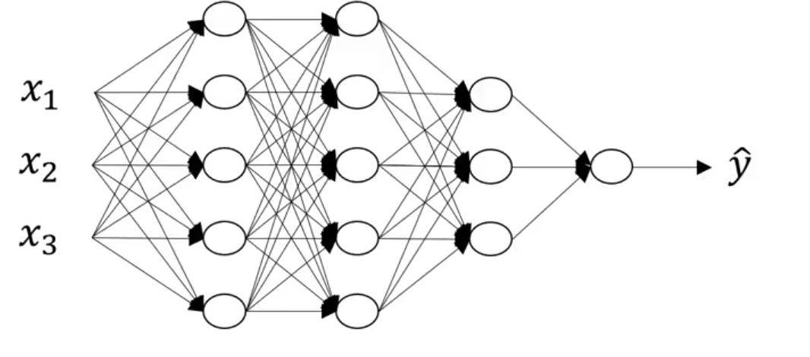
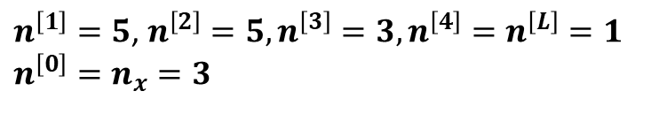
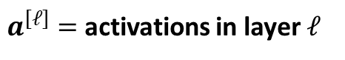
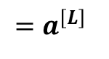
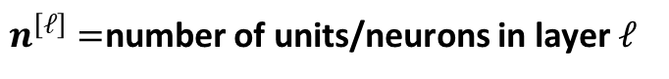
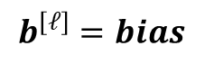
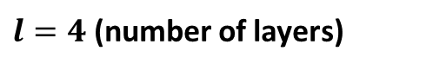
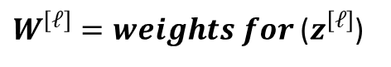
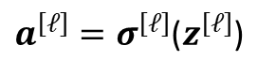
Last time: Deep Neural Network
4 layer NN with 3 hidden layers
$${=a}^{\left[L\right]}$$
1
3
5
5
The number of units in each hidden layer
$n^{\left[1\right]}=5$, $n^{\left[2\right]}=5,n^{\left[3\right]}=3,n^{\left[4\right]}=n^{\left[L\right]}=1$
$$n^{\left[0\right]}=n_{x}=3$$
$l=4$ (number of layers)
$n^{\left[ℓ\right]}=$number of units/neurons in layer $ℓ$
$a^{\left[ℓ\right]}=σ^{\left[ℓ\right]}$($z^{\left[ℓ\right]}$)
$a^{\left[ℓ\right]}=$activations in layer $ℓ$
$W^{\left[ℓ\right]}=weights for$($z^{\left[ℓ\right]}$)
$$b^{\left[ℓ\right]}=bias$$

Slide 6
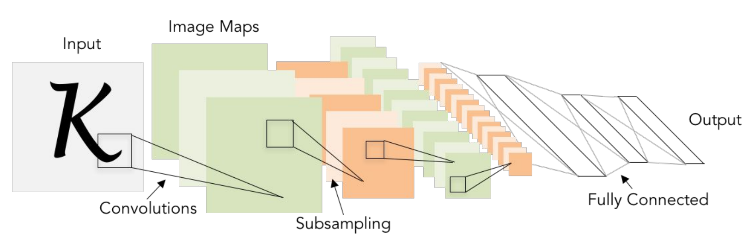
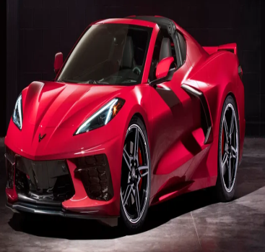
Next: Convolutional Neural Networks

Slide 7
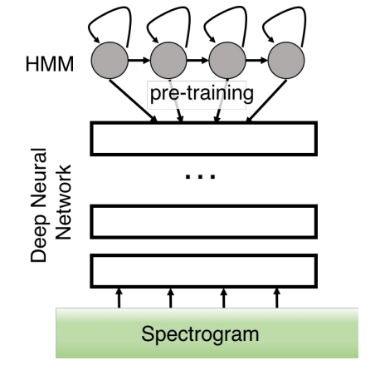
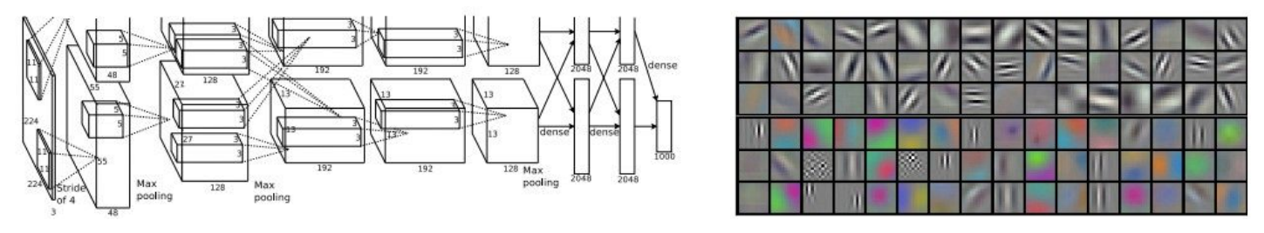
Next: Convolutional Neural Networks
First strong results
Acoustic Modeling using Deep Belief Networks
Abdel-rahman Mohamed, George Dahli, Geoffrey Hinton, 2010
Context-Dependent Pre-trained Deep Neural Networks
For Large Vocabulary Speech Recognition
George Dahli, Dong Yu, Li Deng, Alex Acero, 2012
Figure copyright: George Dehli et al., 2012
Imagenet Classification with Deep Convolutional Neural Network
Alex Krizhevsky, Ilya Sutskever, Geoffrey E Hinton, 2012
Figure copyright: Alex Krizhevsky, Ilya Sutskever, Geoffrey E Hinton, 2012

Slide 8
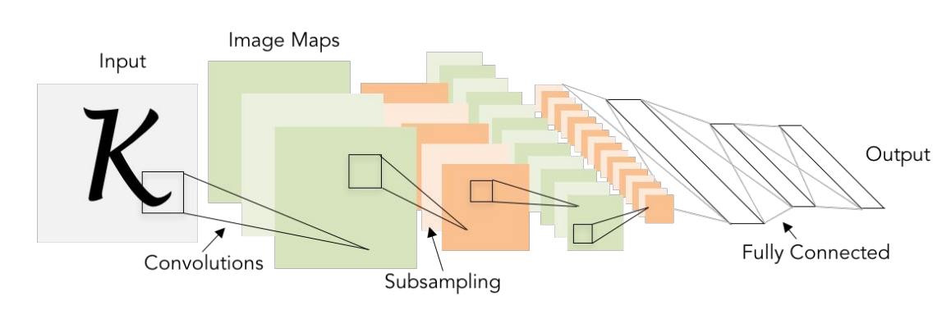
Next: Convolutional Neural Networks
A bit of history
Gradient-based Learning Applied to Document Recognition
LeCun, Bottou, Bengio, Haffner, 1998
LeNet-5

Slide 9
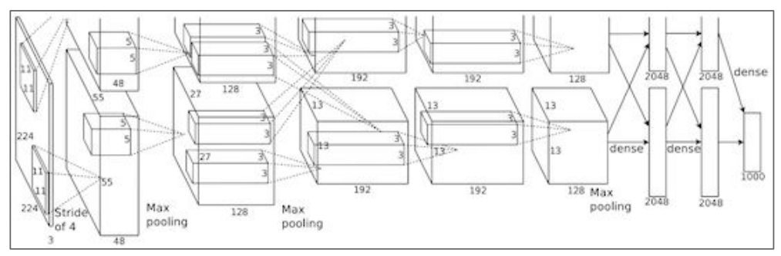
Next: Convolutional Neural Networks
A bit of history
ImageNet Classification with Deep Convolutional Neural Networks
Krizhevsky, Sutskever, Hinton, 2012
Figure copyright: Alex Krizhevsky, Ilya Sutskever, Geoffrey E Hinton, 2012
AlexNet

Slide 10
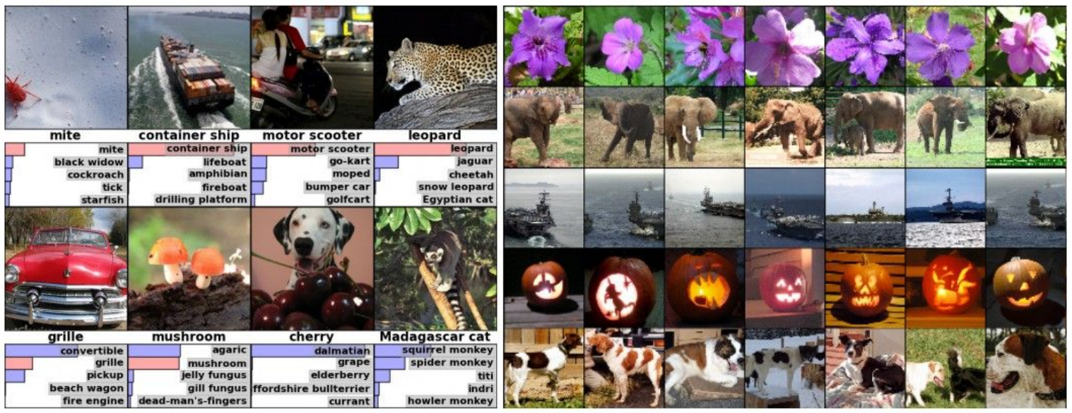
Application of Convolutional Neural Networks
Classification
Retrieval
Figure copyright: Alex Krizhevsky, Ilya Sutskever, Geoffrey Hinton, 2012

Slide 11
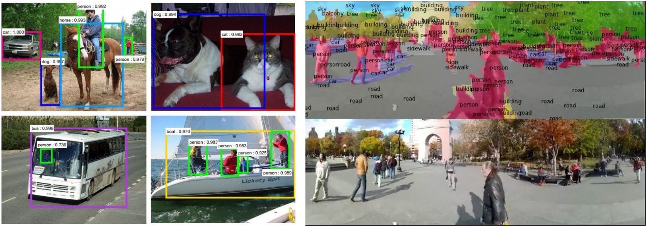
Application of Convolutional Neural Networks
Detection
Segmentation
Figure copyright: Shaoqing et al., 2015
Figure copyright: Farabet et al., 2012

Slide 12
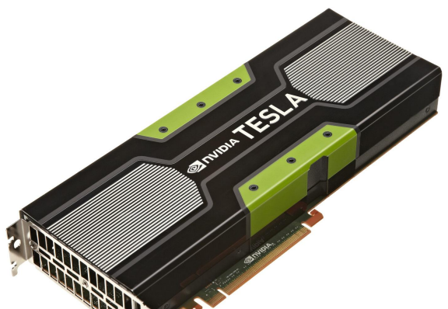
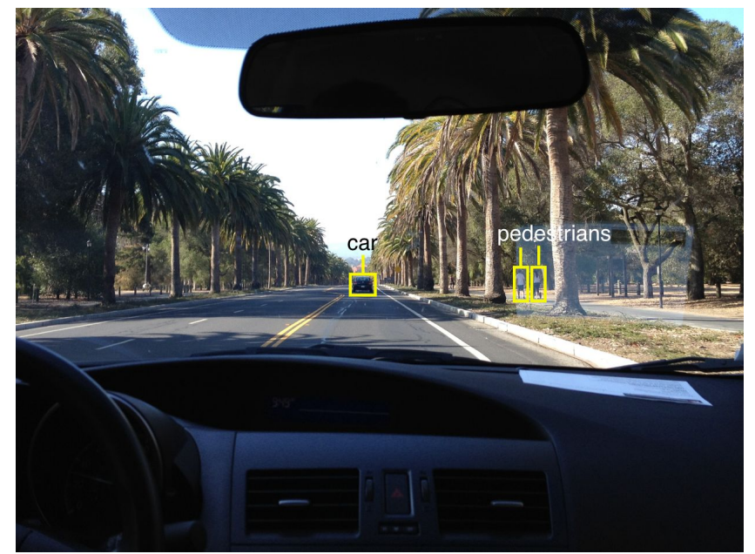
Application of Convolutional Neural Networks
Self-driving cars
NVIDIA GPU machine is an important resource to execute CNN tasks. It is important to setup the GPU work environment in advance.

Slide 13
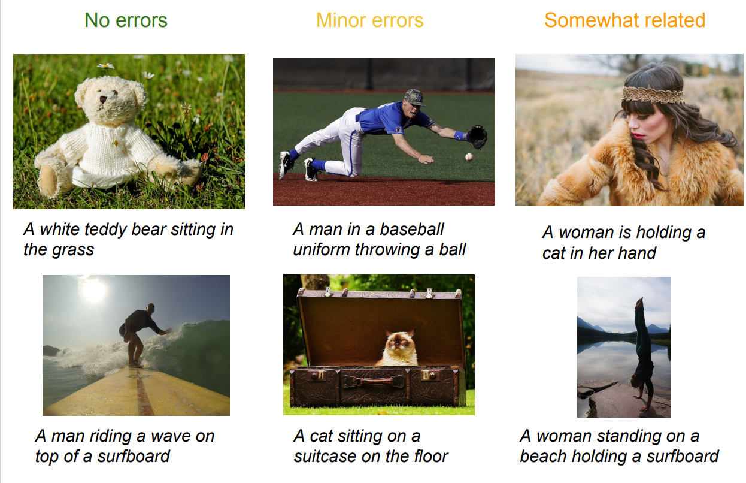
Application of Convolutional Neural Networks
Image Captioning
Figure copyright: Karpathy and Fei-Fei, 2015

Slide 14
Convolutional Neural Networks

Slide 15
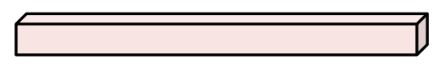

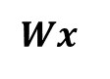
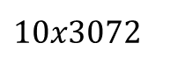
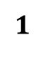
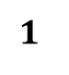
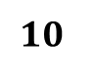
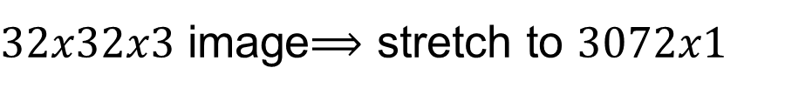
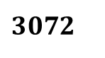
Fully Connected Layer(Dense Layer)
$32x32x3$ image$⟹$ stretch to $3072x1$
Input
Activation
$$Wx$$
$$1$$
$10x3072$
$$1$$
$3072$
Weights
$$10$$

Slide 16
Fully Connected Layer(Dense Layer)
$32x32x3$ image$⟹$ stretch to $3072x1$
Input
Activation
$$Wx$$
$$1$$
$10x3072$
$$1$$
$3072$
Weights
$$10$$
1 number:
the result of taking a dot product between a row of ‘W’ and the input ( a 3072-dimensional dot product)

Slide 17
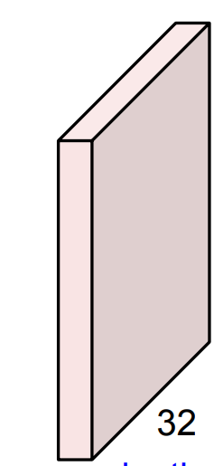
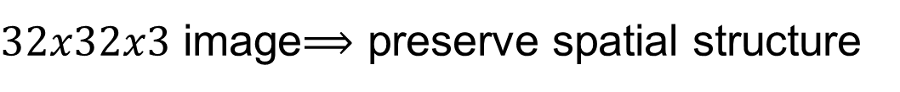
Convolution Layer
$32x32x3$ image$⟹$ preserve spatial structure
32
height
width
3
depth

Slide 18

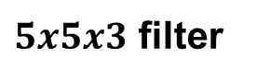
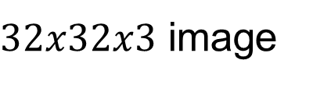
Convolution Layer
$32x32x3$ image
$5x5x3$ filter
32
height
Convolve the filter with the image (slide over the image spatially, computing dot products)
width
3
depth

Slide 19
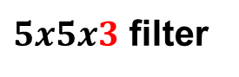
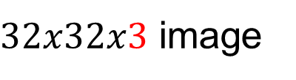
Convolution Layer
Filters always extend the full depth of the input volume
$32x32x3$ image
$5x5x3$ filter
32
height
Convolve the filter with the image (slide over the image spatially, computing dot products)
width
3
depth

Slide 20


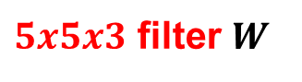
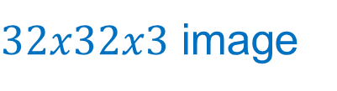
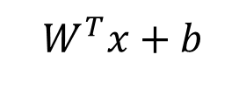
Convolution Layer
$32x32x3$ image
$5x5x3$ filter $W$
32
1 number:
the result of taking a dot product between the filter and a small chunk of the image ( i.e. 5*5*3 = 75-dimensional dot product + bias)
$$W^{T}x+b$$
3

Slide 21
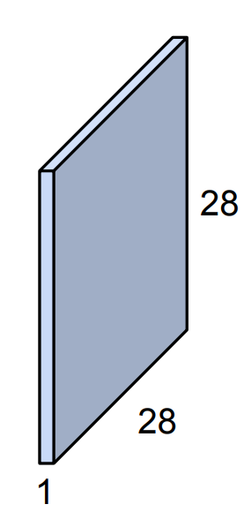

Convolution Layer
$32x32x3$ image
$5x5x3$ filter
Activation map
32
Convolve (slide) over all spatial locations
3

Slide 22
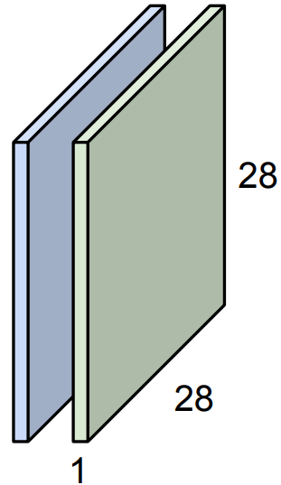

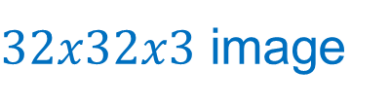
Convolution Layer
Consider a second green filter
$32x32x3$ image
Activation maps
$5x5x3$ filter
32
Convolve (slide) over all spatial locations
3

Slide 23
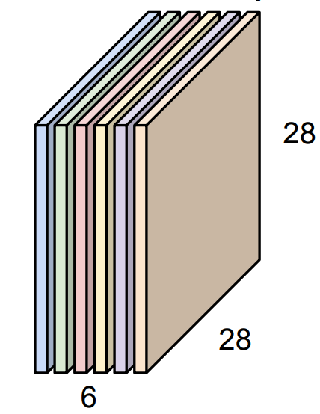
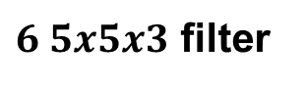
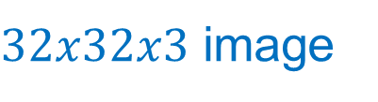
For example, if we had 6 $5x5$ filters, we will get 6 separate activation maps
$32x32x3$ image
Activation maps
$6 5x5x3$ filter
32
Convolution Layer
3
We stack these up to get a “new image” of size $28x28x6$

Slide 24
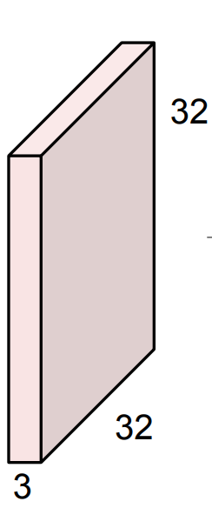
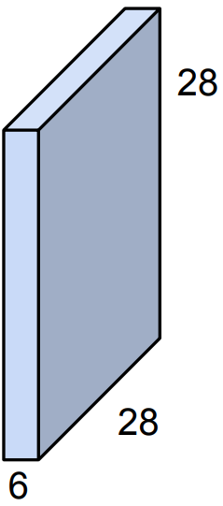
Preview: Convolutional Network is a sequence of Convolution layers interspersed with activation functions.
Conv, ReLU
6 5x5x3 filters

Slide 25
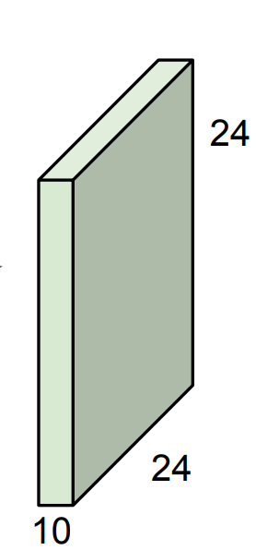
Preview: Convolutional Network is a sequence of Convolution layers interspersed with activation functions.
….
Conv, ReLU
6 5x5x3 filters
Conv, ReLU
10 5x5x6 filters
Conv, ReLU

Slide 26

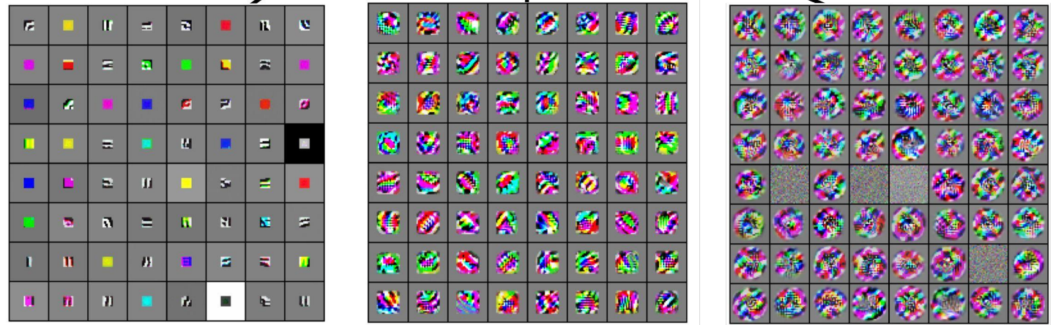
Preview
Zeiler and Fergus, 2013
Visualization of VGG-16 by Lane Mcintosh. [Simonyan and Zisserman, 2014]
Linearly separable classifier
Low-level features
Mid-level features
High-level features
VGG-16 Conv1_1
VGG-16 Conv3_2
VGG-16 Conv5_3

Slide 27
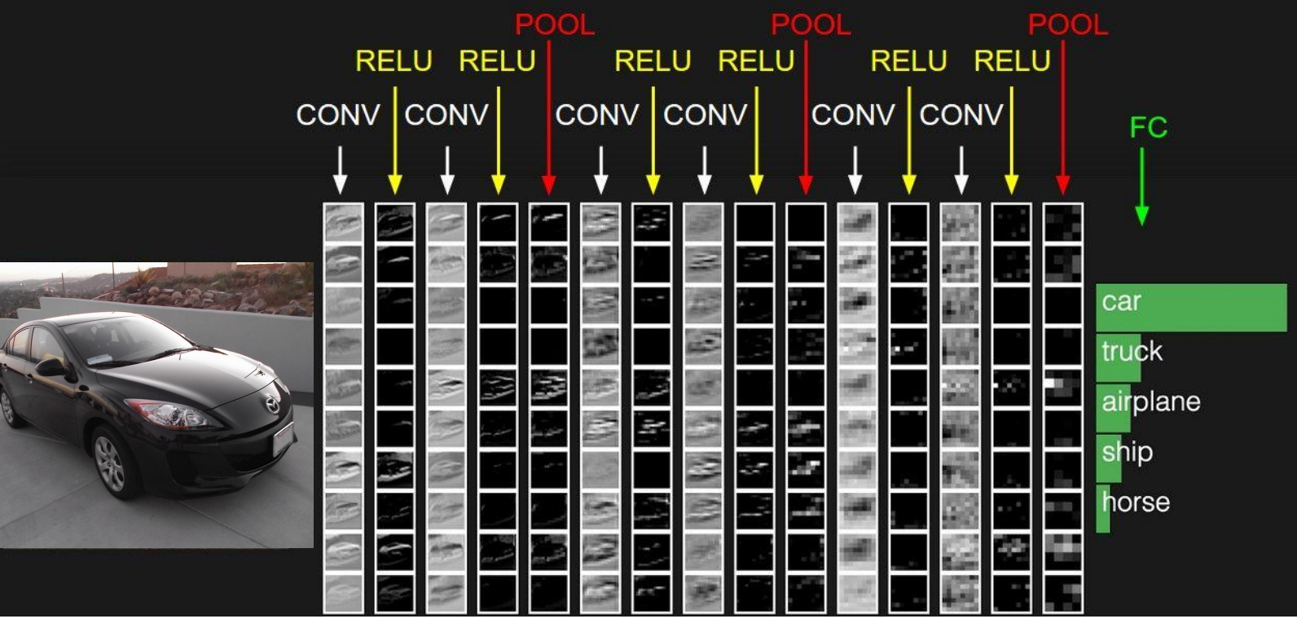
Preview

Slide 28

Take a close look at the spatial dimensions
$32x32x3$ image
$5x5x3$ filter
Activation map
32
Convolve (slide) over all spatial locations
3

Slide 29
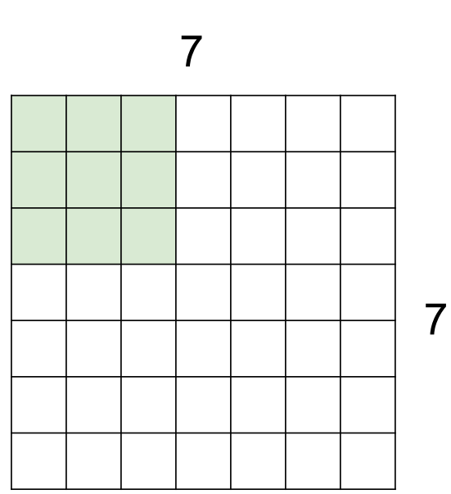
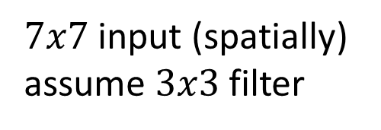
Take a closer look at the spatial dimensions
$7x7$ input (spatially) assume $3x3$ filter

Slide 30

Take a closer look at the spatial dimensions
$7x7$ input (spatially) assume $3x3$ filter

Slide 31

Take a closer look at the spatial dimensions
$7x7$ input (spatially) assume $3x3$ filter

Slide 32

Take a closer look at the spatial dimensions
$7x7$ input (spatially) assume $3x3$ filter

Slide 33


Take a closer look at the spatial dimensions
$7x7$ input (spatially) assume $3x3$ filter
$⟹5x5$ output

Slide 34


Take a closer look at the spatial dimensions
$7x7$ input (spatially) assume $3x3$ filter applied with stride 2

Slide 35

Take a closer look at the spatial dimensions
$7x7$ input (spatially) assume $3x3$ filter applied with stride 2

Slide 36


Take a closer look at the spatial dimensions
$7x7$ input (spatially) assume $3x3$ filter applied with stride 2
$⟹3x3$ output

Slide 37


Take a closer look at the spatial dimensions
$7x7$ input (spatially) assume $3x3$ filter applied with stride 3

Slide 38


Take a closer look at the spatial dimensions
$7x7$ input (spatially) assume $3x3$ filter applied with stride 3
doesn’t fit!
cannot apply $3x3$ filter on $7x7$ input with stride 3

Slide 39





Estimation of spatial dimensions:
$$\frac{\left(N−F\right)}{stride}+1$$
Output size:
e.g. N = 7, F = 3
If stride is 1,
$$\frac{\left(7−3\right)}{1}+1=5$$
If stride is 2,
$$\frac{\left(7−3\right)}{2}+1=3$$
If stride is 3,
$$\frac{\left(7−3\right)}{3}+1=2.33$$

Slide 40



Estimation of spatial dimensions:
$$\frac{\left(N−F\right)}{stride+1}$$
Output size:
e.g. N = 7, F = 3
If stride is 1,
$$\frac{\left(7−3\right)}{1}+1=5$$
If stride is 2,
$$\frac{\left(7−3\right)}{2}+1=3$$
If stride is 3,
$$\frac{\left(7−3\right)}{3}+1=2.33$$
In practice, padding can be introduced to solve this problem

Slide 41




In practice: It is common to pad the border with zero
e.g. input $7x7$
$3x3$ filter, applied with stride 1
Pad the border with 1 pixel$⟹$ what is the output?
$$\frac{\left(N−F\right)}{stride}+1$$
Recall:
With padding:
$$\frac{\left(N−F+2p\right)}{stride}+1$$

Slide 42

In practice: It is common to pad the border with zero
e.g. input $7x7$
$3x3$ filter, applied with stride 1
Pad the border with 1 pixel$⟹$ what is the output?
$7x7$ output

Slide 43




In practice: It is common to pad the border with zero
e.g. input $7x7$
$3x3$ filter, applied with stride 1
Pad the border with 1 pixel$⟹$ what is the output?
$7x7$ output
In general, it is common to see Conv layers with stride 1, filter of size $FxF$, and zero-padding with ${(F−1)}/2$. (This will preserve the size spatially)
e.g. F = 3 $⟹$zero pad with 1
F = 5 $⟹$zero pad with 2
F = 7 $⟹$zero pad with 3

Slide 44

Remember back to … E.g. 32x32x3 input convolved repeatedly with 5x5 filters will shrink the volumes spatially.
(32 $⟹$ 28 $⟹$ 24 …). Shrinking too fast is not good, it doesn’t give good result.
….
Conv, ReLU
6 5x5x3 filters
Conv, ReLU
10 5x5x6 filters
Conv, ReLU

Slide 45


Example Time:
Input volume: $32x32x3$
10 $5x5$ filters with stride 1 and pad 2
What is the output volume size?

Slide 46



Example Time:
Input volume: $32x32x3$
10 $5x5$ filters with stride 1 and pad 2
Output volume size:
$\frac{\left(32−5+\left(2x2\right)\right)}{1}+1=32$
Hence, the output volume size is $32x32x10$

Slide 47

Example Time:
Input volume: $32x32x3$
10 $5x5$ filters with stride 1 and pad 2
What is the number of parameters in this layer?

Slide 48



Example Time:
Input volume: $32x32x3$
10 $5x5$ filters with stride 1 and pad 2
The number of parameters in this layer is:
Each filter has 5x5x3 + 1 = 76 parameters
(+1 is for bias)
$$76x10=760$$
Hence, the number of parameters is $760$

Slide 49


1x1 Convolution layer make perfect sense
1x1 Conv
with 32 filters
( each filter has the size 1x1x64, and performs a 64-dimensional dot product)

Slide 50
Remember: Fully Connected Layer (Dense Layer)
Each neuron looks at the full input volume
$32x32x3$ image$⟹$ stretch to $3072x1$
Input
Activation
$$Wx$$
$$1$$
$10x3072$
$$1$$
$3072$
Weights
$$10$$
1 number:
the result of taking a dot product between a row of ‘W’ and the input ( a 3072-dimensional dot product)

Slide 51









Pooling layer
Makes the representations smaller and more manageable
Operate over each activation map independently
$$224x224x64$$
112$x112x64$
pool
$$224$$
$$112$$
downsampling
$$112$$
$$224$$

Slide 52



Max Pooling
Single depth slice
Max pool with $2x2$ filters and stride 2

Slide 53
Global Average Pooling
Single depth slice
Max pool with $2x2$ filters and stride 2
3 | 5
2 | 2

Slide 54
Fully Connected Layer (FC layer)
Contains neurons that connect to the entire input volume, as in ordinary neural network

Slide 55

Convolutional Neural Network Model
Contains convolutional layers interspersed with activation function, maxpooling layers, dense layer, and a classifier (Output layer).

Slide 56
The End!

